Slide 1
Data exploration given PL&PP correlations
13 Nov 2015

Slide 2
Headline/Conclusions/Next steps ***
Yes, there is a good PP effect on choice that we can go look for
Do NOT just use residuals in place of the PP scores – because, this induces anticorrelation between PL and PP on IC trials
Approach: Use PP scores as is, but always check that you get the same qualitative pattern using the PP-residuals ***
Practically, we may struggle to demonstrate an effect of PP
even if PL-exclusive strategies are only deployed on IC trials, I worry that a PL-exclusive strategy will explain CC trial data sufficiently well (even approximately, if not accurately/actually) that non-PL-exclusive strategies will be overwhelmed in the model comparison (since they will require a doubling of free parameters)

Slide 3
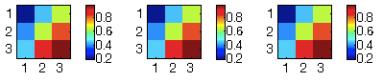
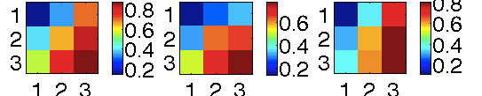
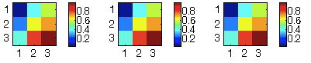
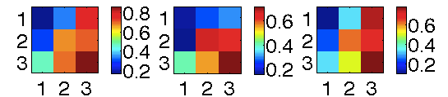
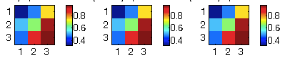
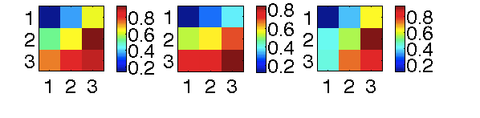
PL & PP scores are inherently correlated, and some of the observed pattern emerges from a PL-exclusive strategy
[CC] Binned according to VChosen
Choose-PL (stochastic) simulations
Here, stochastic sims have draws deleted
Observed choice
p(Chose max PL)
p(Chose max PP)
p(Choose agree w PLPP)
p(Chose max PL)
p(Chose max PP)
p(Choose agree w PLPP)
Overall
Low PL-PP
Corr (CC)
High PL-PP
Corr (CC)
CC trials: PL & PP are correlated within subject (mean r=.62, SD=0.05)
Simulating a PL-exclusive strategy produces Apparent Variance as a Function of (AVFo) PP
But, the observed AVFo-PP is greater than what one would see with a PL-exclusive strategy
→ There is an effect of PP to look for, but we may be slightly hamstrung (possibly as a fxn of PL-PP correlation)

Slide 4
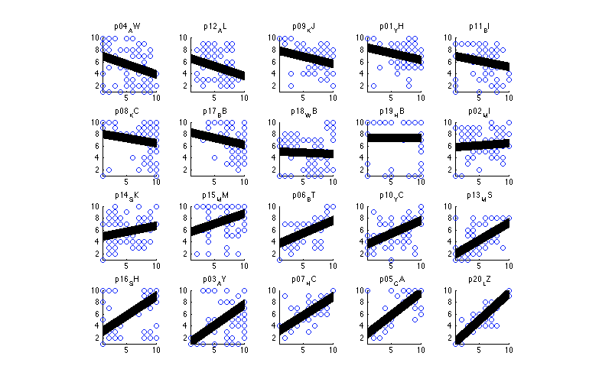
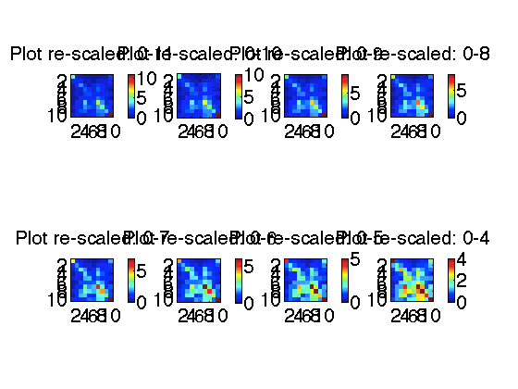
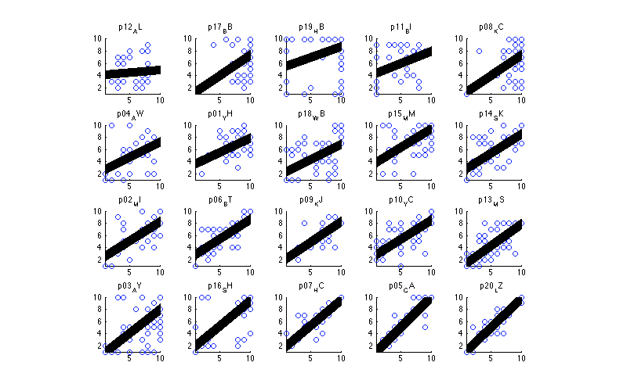
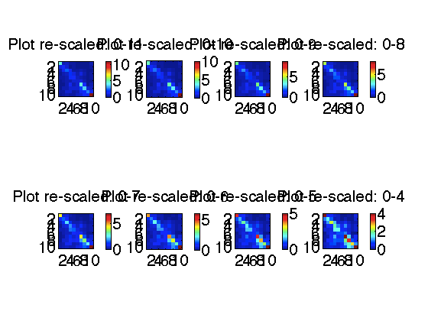
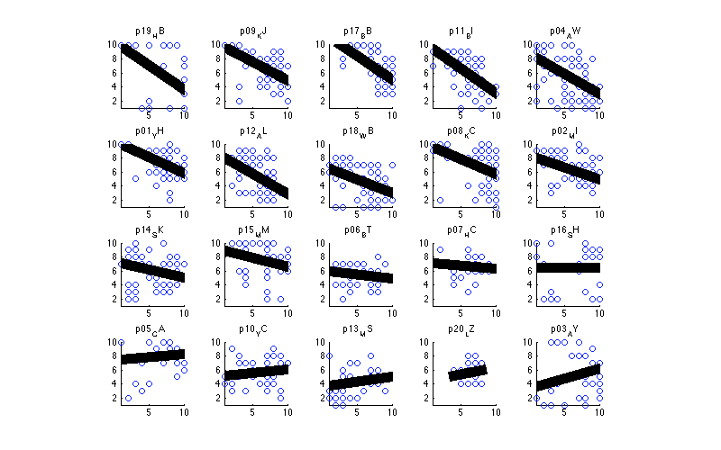
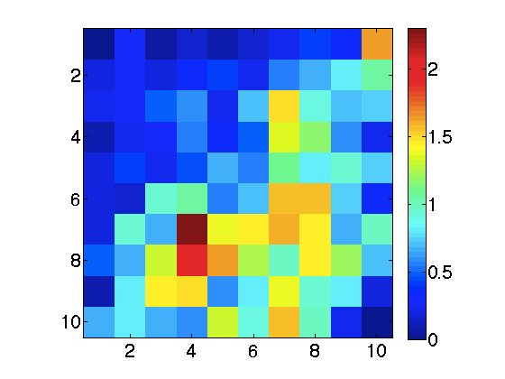
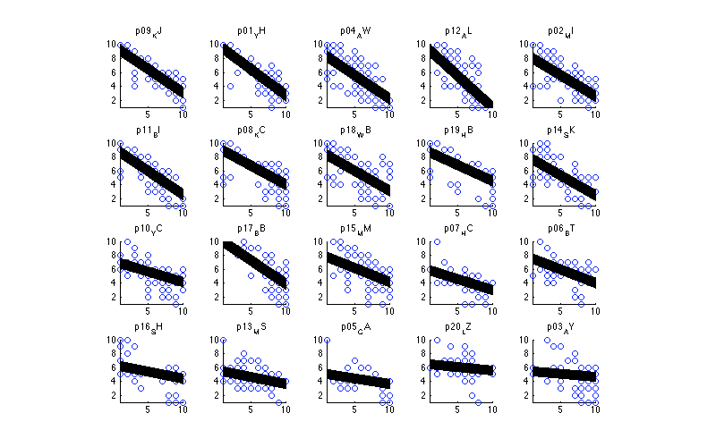
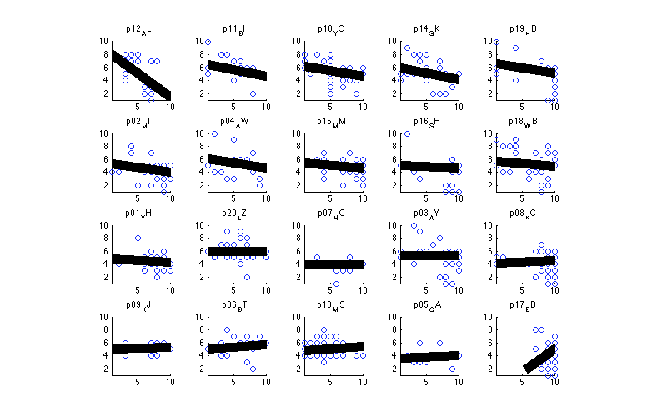
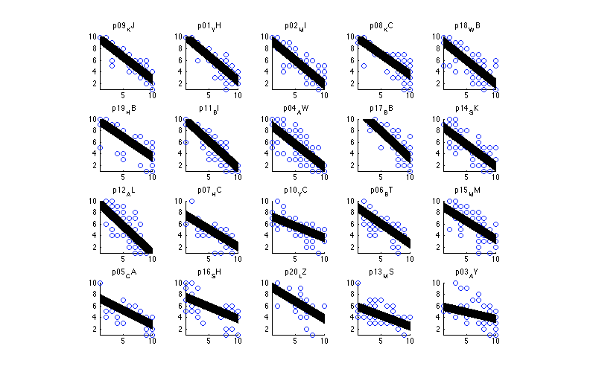
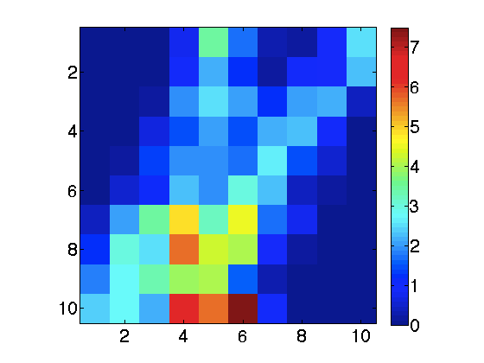
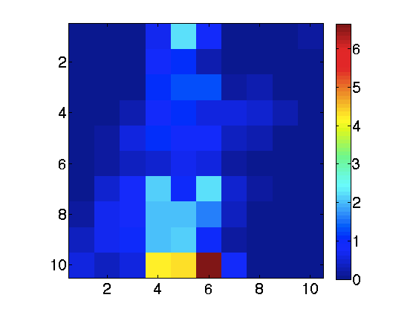
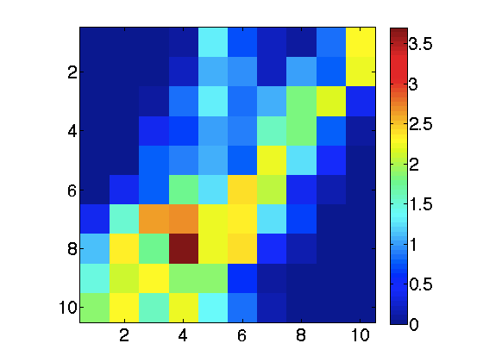
PP artificially decorr from PL
PL & PP de-correlation is performed on all trials (not just CC vs IC). PL are the residuals after regressing out PL.
All trials
Compatible Choice trials
Incompatible Choice trials
+ corr
Original
Mean r= 0.22, SD=0.42
Mean r= 0.62, SD=0.23
Mean r= -0.2603, SD=0.31046
- corr
After decorrelation
Mean r= -0.539, SD=0.17997
Mean r= -0.098, SD=0.2175
Mean r= -0.709,
SD=0.12117
Can’t just stick with the residuals of PP (after PL regressed out) – because this effectively induces anticorrelation between PL & PP in the IC trials
Suggested approach: conduct analysis on raw scores (i.e. not PP residuals), but check for the qualitatively same pattern using the residuals
Note: on CC trials, a PL strategy may do fairly well on CC trials because PL is also predictive of PP.

Slide 5
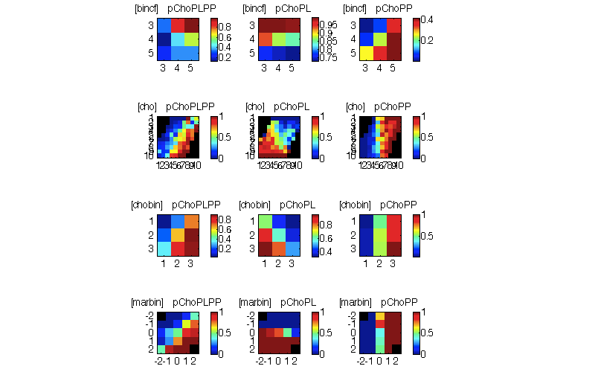
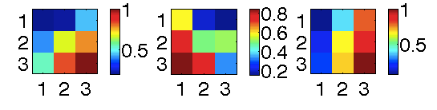
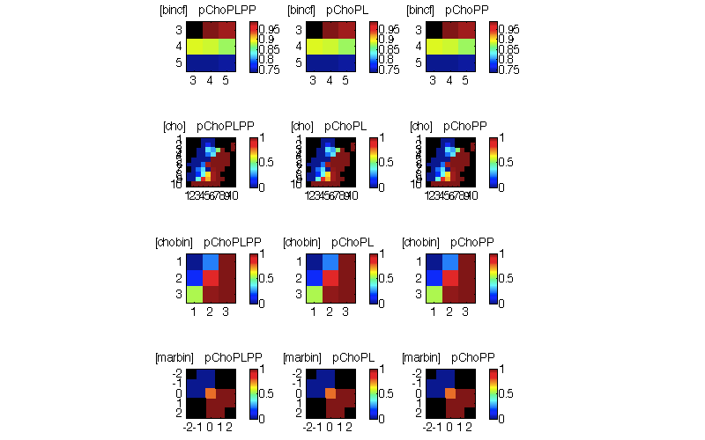
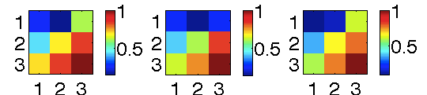
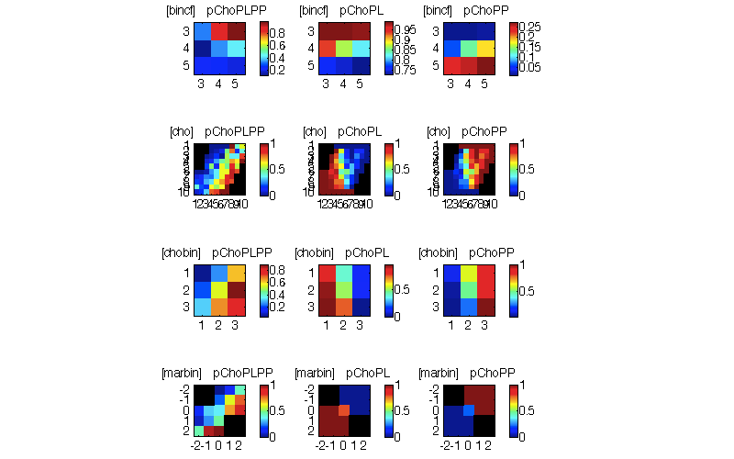
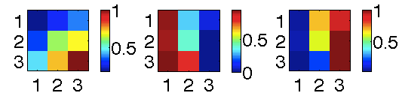
PP = residuals after PL is regressed out (rescaled from 1-10 & rounded)
[All trials] Binned according to VChosen
Choose-PL (stochostic) simulations
Here, draws have been deleted
Observed choice
p(Chose max PL)
p(Chose max PP)
p(Chose max PL)
p(Chose max PP)
p(Choose agree w PLPP)
p(Choose agree w PLPP)
All trials
X
Compatible Choice trials
Incompatible Choice trials
If PL is regressed out of PP, there is still AVFo-PP (where PP=residuals after PL regressed out). i.e. Yes, PP is having a real effect
But, with a stochastic simulation, a PL-exclusive strategy still somewhat produces AVFo-PP (residual PL-PP corr?)
Note that a deterministic simulation doesn’t produce this effect. May be residual PL-PP correlation driving the AVFo-PP

Slide 6
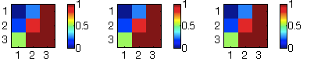
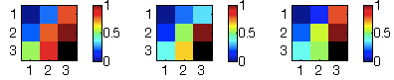
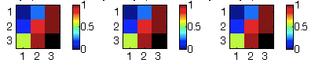
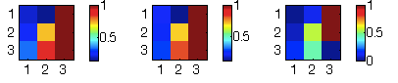
PP = residuals after PL is regressed out (rescaled from 1-10 & rounded)
[CC] Binned according to VChosen
Choose-PL (stochastic) simulations
Here, stochastic sims have draws deleted
Observed choice
p(Chose max PL)
p(Chose max PP)
p(Choose agree w PLPP)
p(Chose max PL)
p(Chose max PP)
p(Choose agree w PLPP)
Overall
Overall, PL & PP are not very correlated (after PL is regressed out of PP).
So, no need to look at the median split according to PL-PP correlation
Low PL-PP
Corr (CC)
High PL-PP
Corr (CC)
Stronger + rel between PL & PP
Is there a greater AVFo-PP in behaviour, compared to the AVFo-PP from choosing PL?
Pattern here is hard to discern.
Median split PL-PP correlation is now determined on PL-PP corrs after PP has had PL decorr from it. Low corr: mean r=-0.06, High corr, mean r=0.39

Slide 7
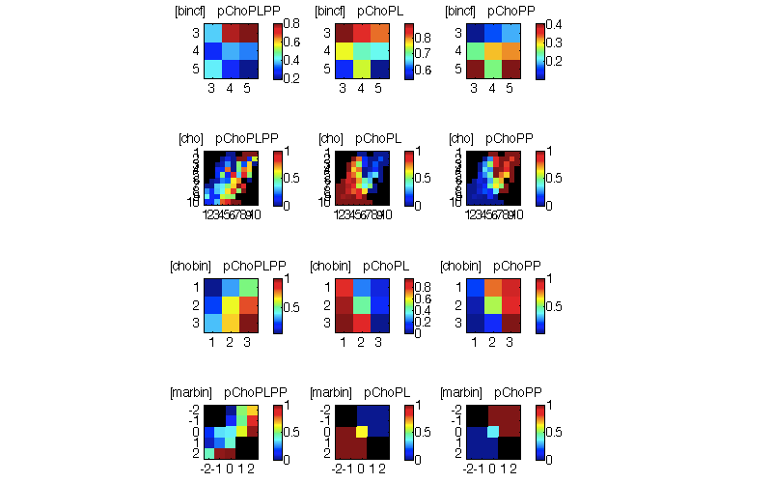
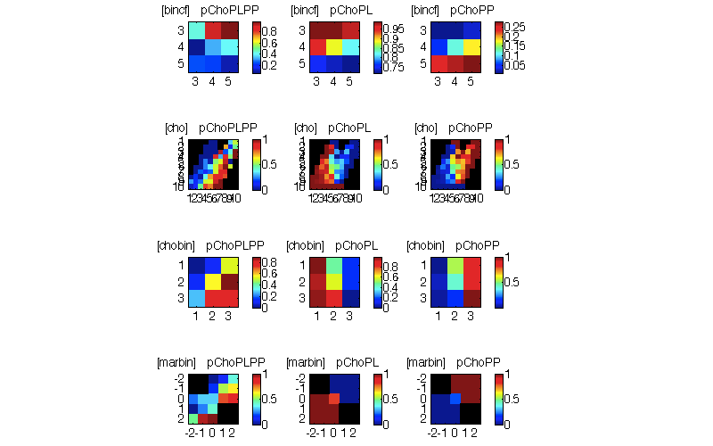
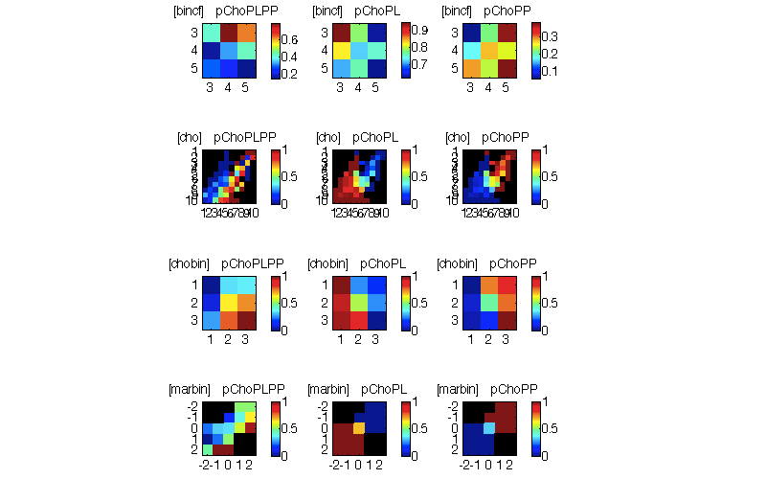
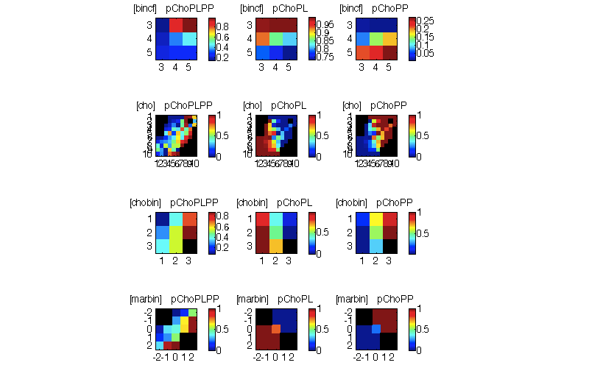
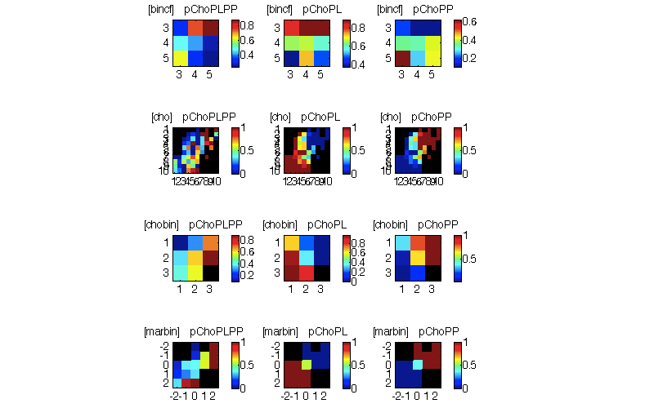
PP = residuals after PL is regressed out (rescaled from 1-10 & rounded)
[IC] Binned according to VChosen
Not very useful
Choose-PL (stochastic) simulations
Here, stochastic sims have draws deleted
Observed choice
p(Chose max PL)
p(Chose max PP)
p(Choose agree w PLPP)
Don’t look at PLPP
p(Chose max PL)
p(Chose max PP)
p(Choose agree w PLPP)
Don’t look at PLPP
Overall
Low PL-PP
Corr (IC)
More anticorr!
High PL-PP
Corr (IC)
PL & PP are anticorrelated here.
Median split PL-PP correlation is now determined on PL-PP corrs after PP has had PL decorr from it.

Slide 8
Binned according to cf

Slide 9
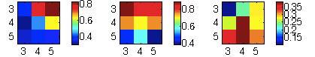
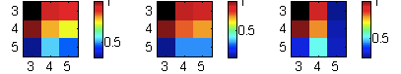
PP = residuals after PL is regressed out (rescaled from 1-10 & rounded)
[Binned according to cf]
Choose-PL (stochostic) simulations
Here, draws have been deleted
Observed choice
p(Chose max PL)
p(Chose max PP)
p(Chose max PL)
p(Chose max PP)
p(Choose agree w PLPP)
p(Choose agree w PLPP)
All trials
Compatible Choice trials
X
Incompatible Choice trials
The CC pattern that is seen (with cf binning) is not generated using a choose-PL strategy == good! ☺

Slide 10
PP = residuals after PL is regressed out (rescaled from 1-10 & rounded)
[IC] Binned according to cf
Not useful
Choose-PL (stochastic) simulations
Here, stochastic sims have draws deleted
Observed choice
p(Chose max PL)
p(Chose max PP)
p(Choose agree w PLPP)
p(Chose max PL)
p(Chose max PP)
p(Choose agree w PLPP)
Overall
Low PL-PP
Corr (IC)
High PL-PP
Corr (IC)
Note that these figures max out pretty low!
Median split PL-PP correlation is now determined on PL-PP corrs after PP has had PL decorr from it.

